Slide 1
GLUIT API
Viewer, button, slider,
Tga I/O, OBJ loader, STL loader
Bitmap and vector fonts

Slide 2
Viewer API
int ViewerNew (int parent, int x, int y, int w, int h, void *content(void))
void ViewerRedisplay (int win)
void ViewerReshape (int win)
Spherical Viewer
(x,y): its location w.r.t. parentWindow
Origin at upper left (glut)

Slide 3
Viewer API (cont)
void ViewerMouseMotion (int win, void (*mouse)(int, int, int, int),void (*motion)(int,int))
void ViewerAddClicker (int win, void (*mouse)(int,int,int,int))
void ViewerFOVY (int win, float fovy)
void ViewerCenter (int win, float x, float y, float z)
void ViewerExtent (int win, float extent)
當在viewer中要用到右鍵點選時

Slide 4
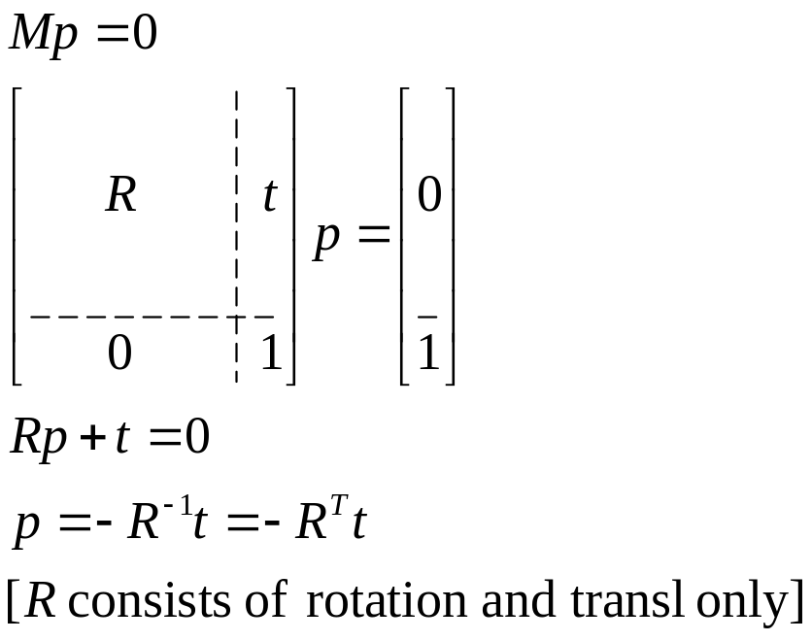
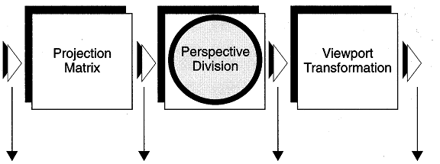
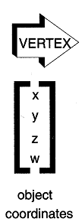
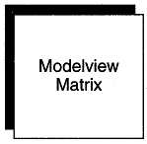
Where is the camera?
Similarly, the up direction can be obtained
For any reason (e.g., cylindrical billboard), you want to know where camera is, just remember that the eye coordinate of the camera is always at the origin [facing –Z]
Modelview
Matrix
Model
Transform
Viewing
Transform
world
coordinates

Slide 5
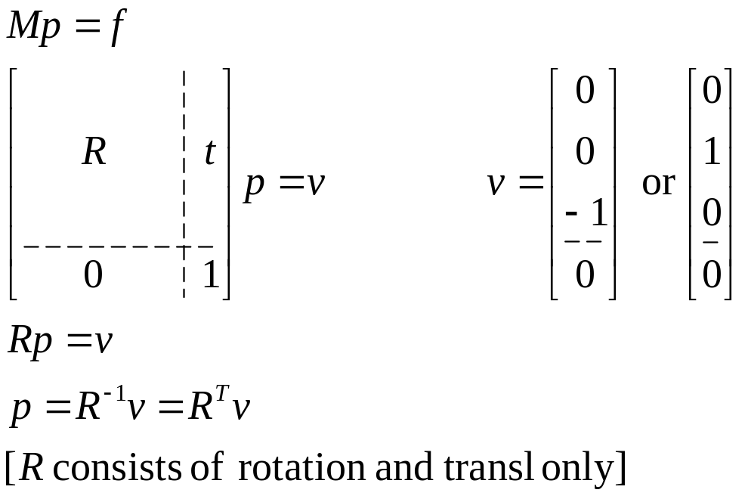
Up and Forward Directions
Spherical Viewer

Slide 6
Bitmap Font API
void setfont(char* name, int size)
  valid combinations:
  "helvetica" [10], 12, 18
  "times roman" [10], 24
  "8x13", "9x15"
  Default: helvetica18
void drawstr(GLuint x, GLuint y, char* format, ...)
  usage:
  drawstr (x, y, "hello world");
  drawstr (x, y, "answer is %d", ans);

Slide 7
Vector Font API
void plotstr (GLfloat x, GLfloat y, char *format, ...)
3D versions:
  Void Drawstr (float x, float y, float z, char *format, …)
  Void Plotstr (float x, float y, float z, float scale, char *format, …)

Slide 8

OBJ (Wavefront) File Structure
Outline
  v: geometry, vn: vertex normal, vt: texture coordinates
  f: face specification (v)/(vt)/(vn)
    vertex count starting from 1
  mtllib: material library
  usemtl: material name
  #: comments
  g: group
References: (1)

Slide 9
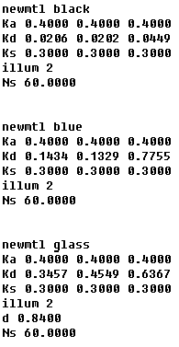
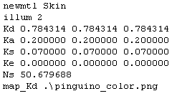
Typical MTL File
Ns: shininess
OBJ [0,1000]→OpenGL [0,128]

Slide 10
Using OBJ Loader
Files: glm.c, glm.h (from Nate Robin)
Related:
  Free 3D models on the Internet (3dcafe, …)
  Model converter (deep exploration)
Important APIs:
  glmUnitize (m)
  glmFacetNormals (m)
  glmVertexNormals (m)
  glmLinearTexture (m)
  glmSpheremapTexture(m)
  glmDelete (m)
  glmScale(m,scale)
  glmReadOBJ (filename)
  glmDraw (m, mode)
  glmList (m, mode)
See glm.h for more details

Slide 11
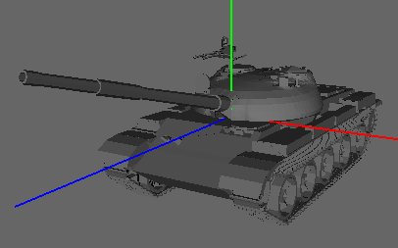
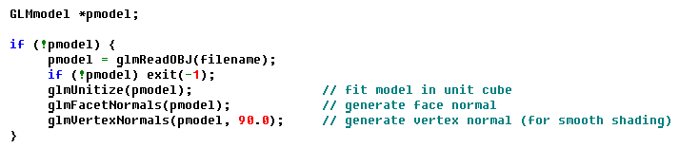
Typical Use
Load model
centered at origin, [-1,1]³ bounded
Render model
  glmDraw (pmodel, mode);
  mode: bitwise-ORed options
  GLM_FLAT, GLM_SMOOTH, GLM_MATERIAL, GLM_TEXTURE (for models with textures)
Example:
  glmDraw (pmodel, GLM_SMOOTH | GLM_MATERIAL);
  glmDraw (pmodel, GLM_SMOOTH | GLM_MATERIAL | GLM_TEXTURE);

Slide 12
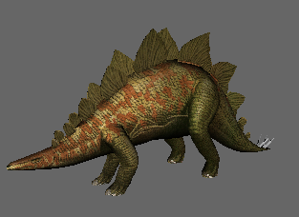
OBJ Models with Textures
Draw model using glmDraw (GLM_SMOOTH|GLM_MATERIAL|GLM_TEXTURE);
Only load png textures

Slide 13
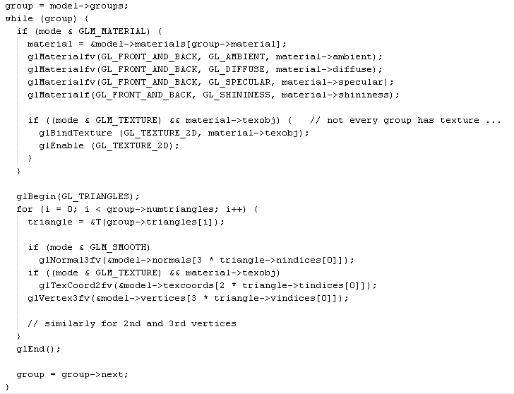
What exactly is in glmDraw?
Every group has one material!

Slide 14
Restrictions
One “usemtl” per group
Only “map_Kd” is handled

Slide 15
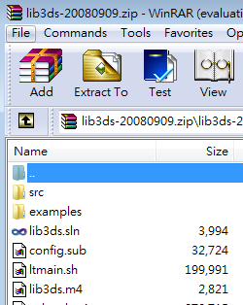

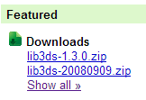
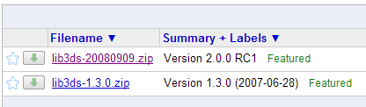
For 3DS Models
Builds: 3ds2obj & 3dsdump

Slide 16
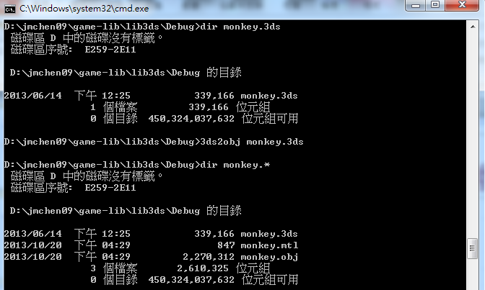
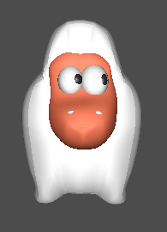
Example: 3ds2obj

Slide 17
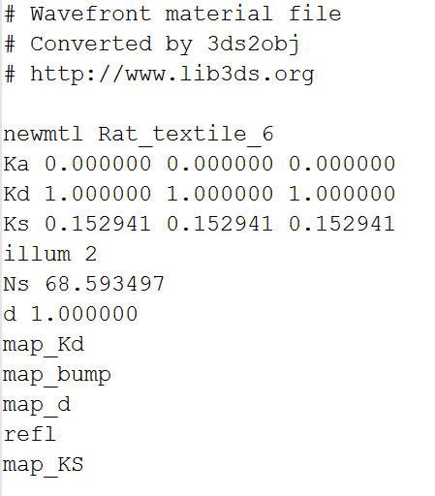
3ds2obj: minor problem
This translator is prepared for a variety of textures, even they don’t exist
However, the OpenGL loader cannot handle attributes of NIL data
Need to remove them (by a text editor)!!

Slide 18
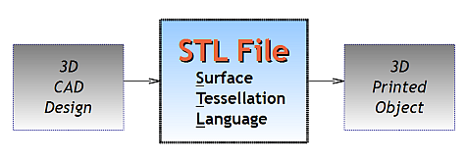
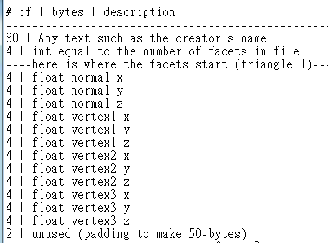
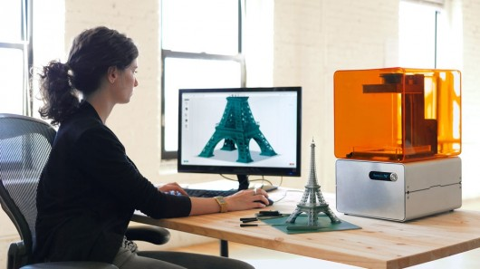
STL Models
Current implementation
reads binary files only
Format for 3D printing
File format (binary)

Slide 19
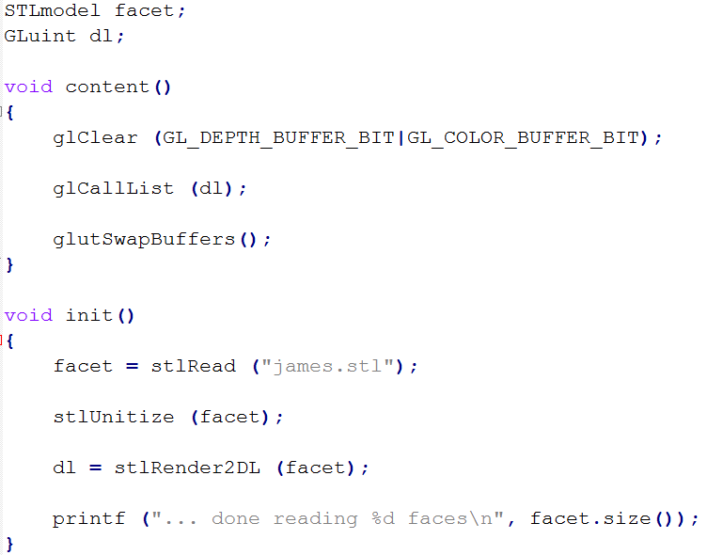
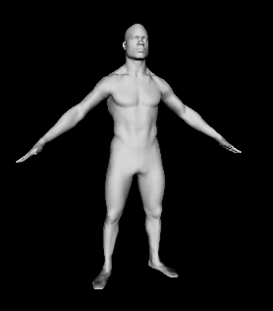
STL Loader
Default rendering:
flat shaded triangles
STLmodel is a vector of FACET

Slide 20

Macros defined (macros.h)
w, h: positive integers
BEGIN_2D_OVERLAY(w,h)
  Set up 2D projection/modelview environment
  ALL attributes pushed; depth test disabled
END_2D_OVERLAY()
CHECK_ERROR(str)
CHECK_OPENGL_ERROR(cmd)

Slide 21
TGA utilities
tgaInfo* tgaLoad(char *filename);
int tgaSave(char *filename, short width, short height, unsigned char pixelDepth, unsigned char *imageData);
int tgaSaveSeries(char *filename, short width, short height, unsigned char pixelDepth, unsigned char *imageData);
int tgaGrabScreenSeries(char *filename, int x,int y, int w, int h);

Slide 22
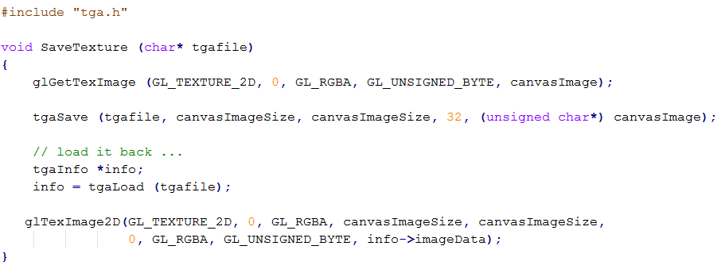
何時用TGA utility?
Save color buffer content
Read TGA file as texture/image

Slide 23
OBJ loader problems

Slide 24
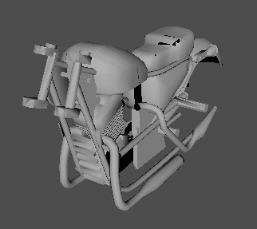
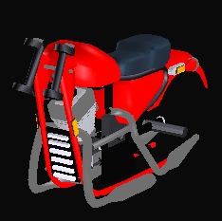
OBJ Reader Bug (usemtl)
DeepExploration
glmDraw: with material
Why certain OBJ files lose its colors?
See how “Al, the gangster” works

Slide 25
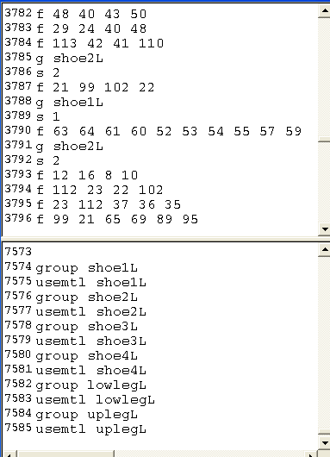
The Trick
Basic problems:
  Only one material per group (limited by the parser)
  How material of a group is specified: usemtl is applied at the end of file

Slide 26
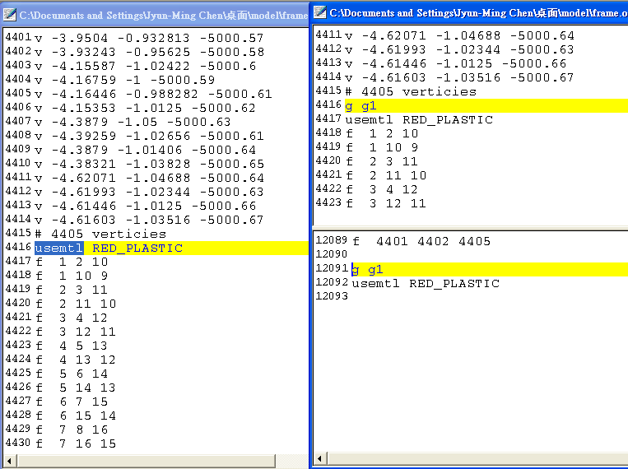
The Hack
2. Make it a group
3*. Copy group and usemtl to end of file
1. Search usemtl

Slide 27
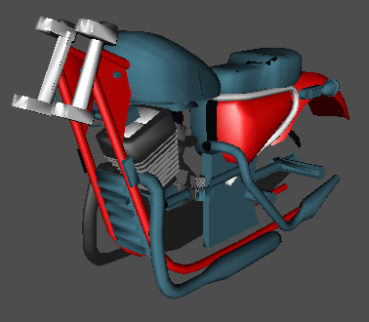
Finally, …
I got something that looked OK (I haven’t finished the fixing).
You can certain be smarter in this effort (QueryReplace, …)
Experiment with smaller parts

Slide 28
GUI Codes
no longer used (replaced by FLTK)

Slide 29
Slider API
void SliderReshape (int win)
int SliderNew (int parent, int x, int y, int w, int h, GLubyte *rgb, float percent, void *update(float), [char*])
Label attached to the slider [Opt. in CPP]

Slide 30
Button API
Text
Text
void ButtonReshape (int win)
int ButtonNew (int parent, int x, int y, int w, int h, GLubyte *rgb, char *text, void *action(void), char* on-text)
Desired aspect ratio 1:2
Suitable for action
  For toggling application, use checkbutton

Slide 31
CheckButton
Text
void CheckButtonReshape (int win)
int CheckButtonNew (int parent, int x, int y, int w, int h, char *text, Glboolean *varptr, int viewer)
CheckButton is linked to a global boolean variable
“viewer” got redisplayed when pressed
Desired aspect ratio: 1:4

